Slide 1
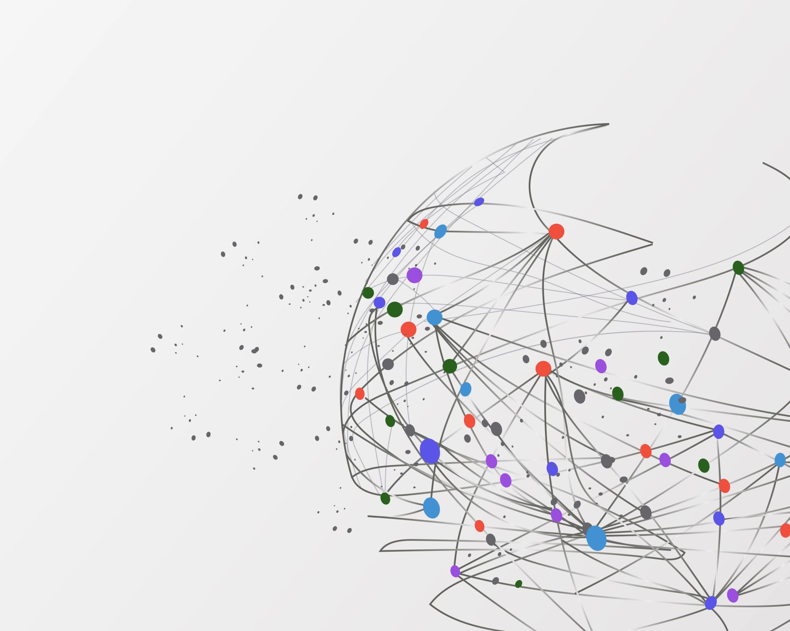
Food and Recipe Recommender
LHL Final Project by Cynthia Okaja
14th September 2023

Slide 2
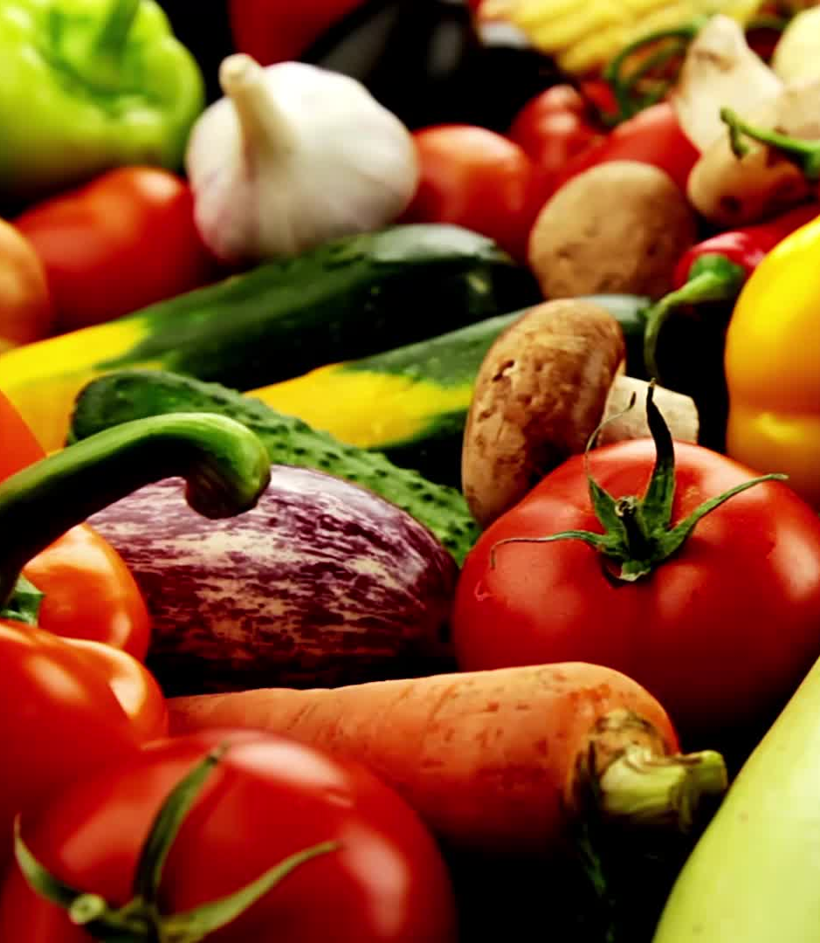
Project Goals
To create a recommender system that will assist users in finding recipes that match the ingredients they currently have in their kitchen and recommend similar recipes based on their preference.
Notes:
It will also have an option for their dietary preference

Slide 3

Project Execution
Data Gathering
Data Preprocessing
EDA
Recommender Systems

Slide 4
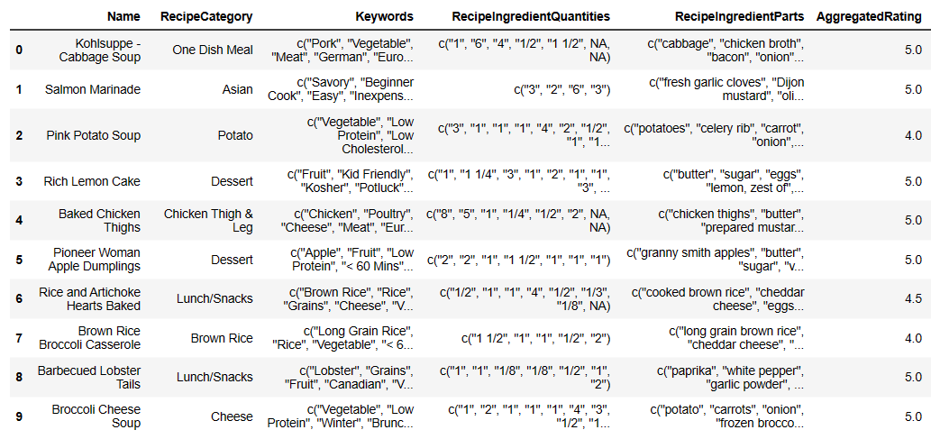
Data Gathering & Preprocessing
Data Source - Foodcom Recipes and Reviews
Getting familiar with the dataset and merging the two df
Dropped null values and selected columns of interest
Created a sample df of 10,000 rows
Notes:
Decied to make use of 2 datasets from Kaggle, preprocessed it and created a sample df of 10,000 rows as the merged df had over a million rows of recipes

Slide 5
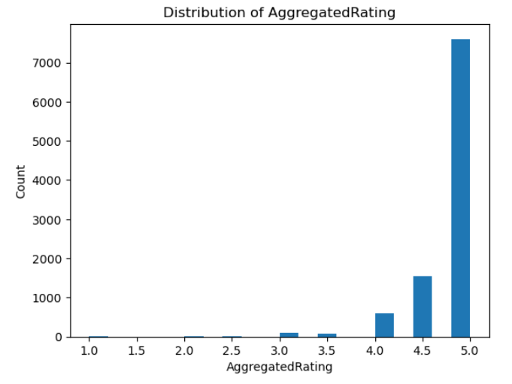
EDA
Histogram of Aggregated Ratings
Notes:
EDA to better understand the dataset…..Histogram showing the aggregated ratings and it can be seen that majority of the reviews were good from 4.0 – 5.0
Used wordcloud to see a quick view of some of the keywords like low protein, kid friendly

Slide 6
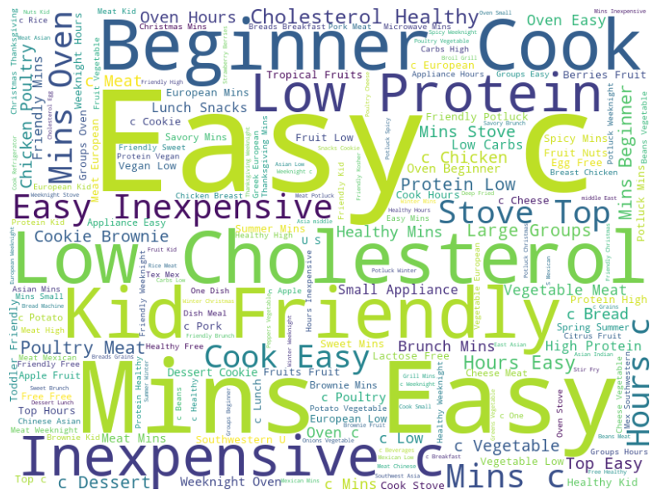
EDA
Wordcloud of Keywords
Notes:
EDA to better understand the dataset…..Histogram showing the aggregated ratings and it can be seen that majority of the reviews were good from 4.0 – 5.0
Used wordcloud to see a quick view of some of the keywords like low protein, kid friendly

Slide 7
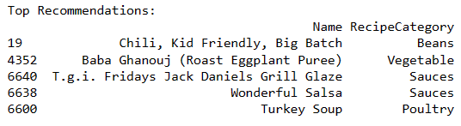
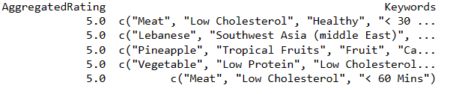
Food Recommender
Simple recommender
Collecting user input
Filtered recipes based on dietary preference
Filtered recipes with matching ingredients
Sorted results based on the top aggregated rating
Output

Slide 8
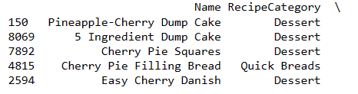
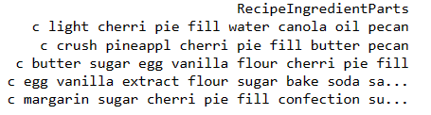
Food Recommender using NLP
Text Preprocessing – “Ingredients”
Tokenization and lowercasing
Removing stopwords
Stemming
Content based recommendation using TF-IDF
TF-IDF vectorization
Calculate cosine similarity between recipes based on ingredients
Defining recommendation based on user history
Notes:
Natural Language Processing
stemming is the process of reducing a word to its base or root form
Tokenization is the process of breaking down a text into individual words or tokens
Stop words are common words like "the", "is", "in", etc., that occur frequently in a language but don't carry much meaningful information for most NLP tasks.
By removing stop words, you can reduce the dimensionality of your data and focus on the more important and meaningful words in a text
TF-IDF ---- This technique is commonly used in tasks like information retrieval, text classification, and clustering, as it helps in capturing the importance of specific words in a document relative to a larger collection of documents.

Slide 9
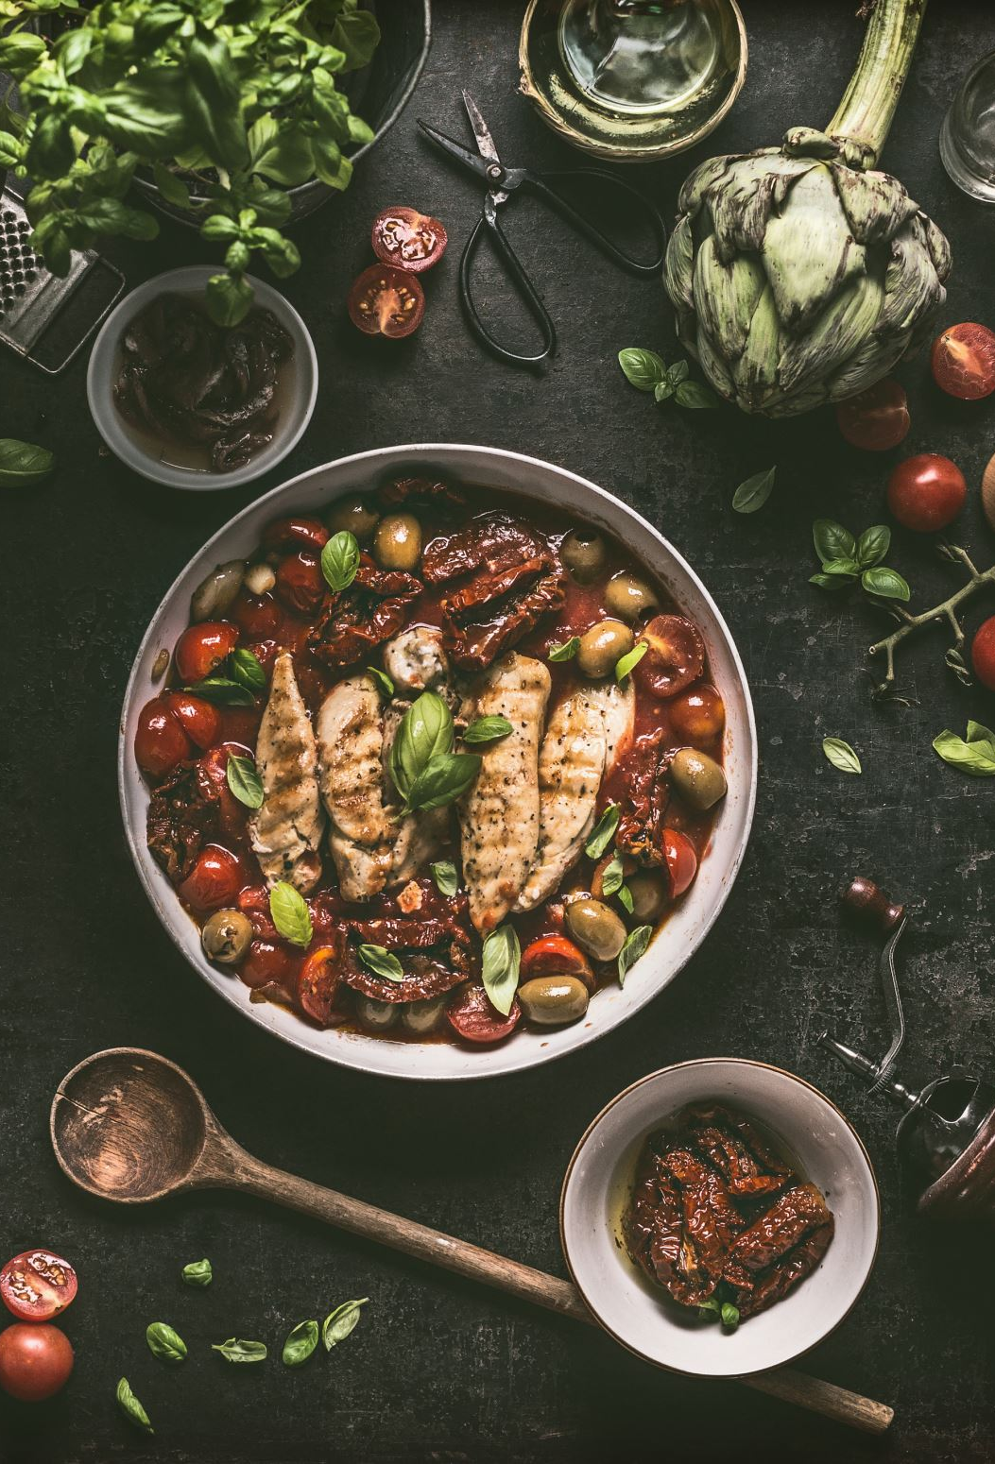
Conclusion
Was able to collect user input and personalized recommendation models to provide users with the most relevant recipe suggestions

Slide 10

Challenges and Future Goals
Challenges
Data Sourcing – Spoonacular API
Handling large dataset – long code run time
Future Goals
Deployment - for users to input their preferences and view recipe recommendations
Better workstation to handle recommendation system using more recipes
Notes:
Create a user-friendly interface (e.g., web application) for users to input their preferences and view recipe recommendations

Slide 11

THANK YOU

